Slide 1
Kineski novi putevi svile
RC Zagreb Gradec
7. ožujka 2024.
Zoran Žic
RC Zagreb Sljeme

Slide 2
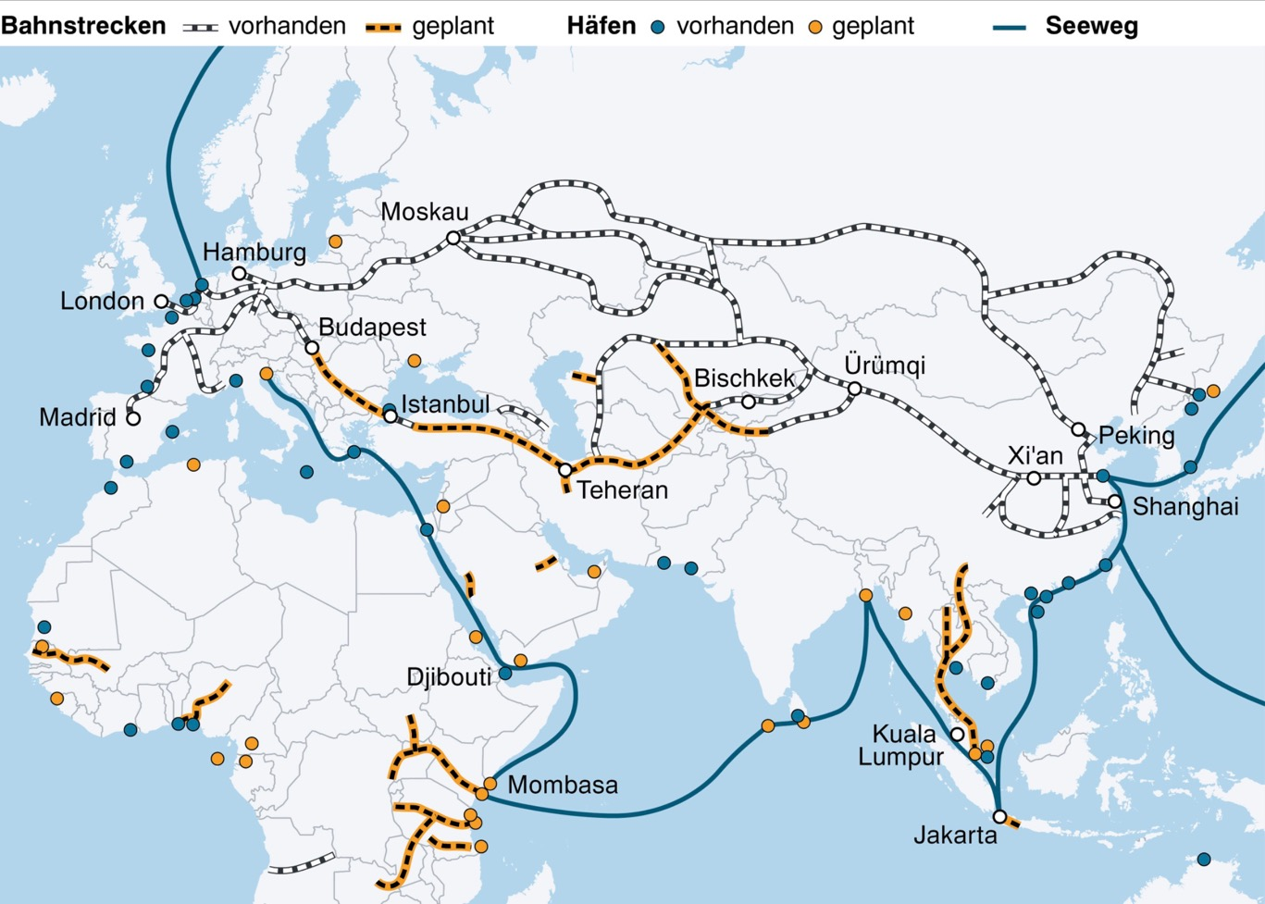
New Silk Roads
CHINA - BRI
Belt and Road Initiative
New
Silk Roads:
5 roads

Slide 3
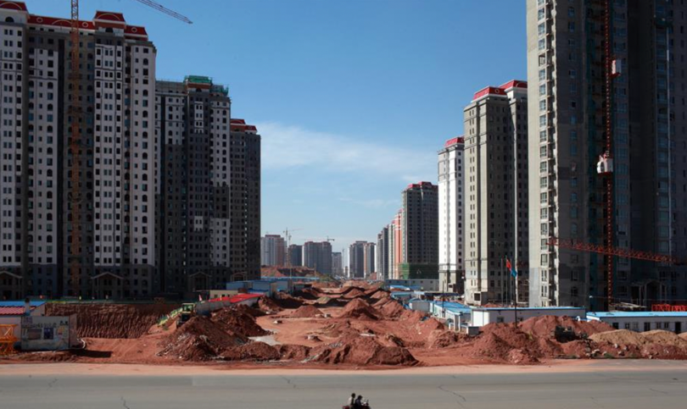
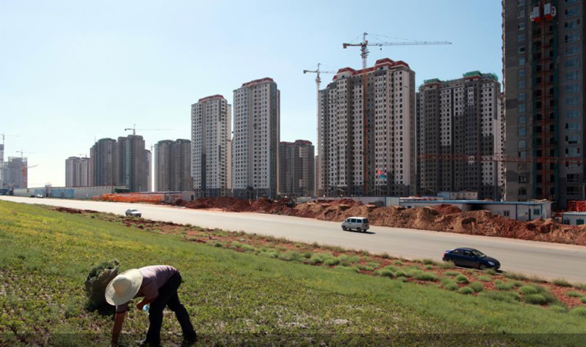
China Today - Challenges
Since 2017…
… state capitalism is getting stronger
… 400 million more in urban area (20years)
… the real estate industry is (almost)
bankruptcy
- Evergrande (-300 billion USD)
- Country Garden (-190 billion USD)
… ghost cities (70 million flats empty)
… demographic crisis since 2022
1-child policy came to 4-2-1 problem
… everlasting friendship with Russia
… chip-war with USA (Taiwan)

